Slide 1
Data Processing

Slide 2
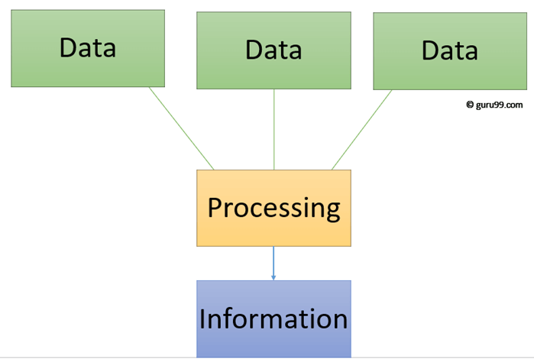
Difference between Data & Information
Data are simply facts or figures, bits of information, but not information itself. When data are processed, interpreted, organized, structured or presented so as to make them meaningful or useful, they are called information.
Example:
The history of temperature readings all over the world for the past 100 years is data. If this data is organized and analyzed to find that global temperature is rising, then that is information.

Slide 3
Data Representation
Computers have their own number system, called Binary Number System.
Computers use binary - the digits 0 and 1 - to store data.
A binary digit, or bit, is the smallest unit of data in computing.
It is represented by a 0 or a 1.
Binary numbers are made up of binary digits (bits), e.g. the binary number 1001

Slide 4
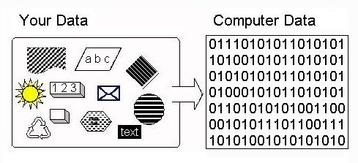
Data Representation
Binary and Switches. Binary is a mathematical number system: a way of counting. We have all learned to count using ten digits: 0-9. One probable reason is that we have ten fingers to represent numbers. The computer has switches to represent data and switches have only two states: ON and OFF. Binary has two digits to do the counting: 0 and 1 - a natural fit to the two states of a switch (0 = OFF, 1 = ON).

Slide 5
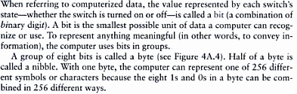
Bits and Bytes
e:
0 | 1 bit
1 | 1 bit
0110 | 4 bits
01101011 | 8 bits
01000011
Bits Representation
8 bits = 1 Byte

Slide 6

Text Codes
EBCDIC: Extended Binary Coded Decimal Interchange Code
ASCII: American Standard Code for Information Interchange
Extended ASCII
Unicode: Unicode Worldwide Character Standard

Slide 7
Data Processing
Components that handle the data processing are:
Central Processing Unit
Memory
Buses

Slide 8
Central Process Unit (CPU)
Central Processing Unit (CPU) consists of the following features −
CPU is considered as the brain of the computer.
CPU performs all types of data processing operations.
It stores data, intermediate results, and instructions (program).
It controls the operation of all parts of the computer.

Slide 9
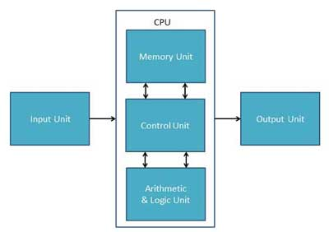
Central Process Unit (CPU)
CPU itself has following three components.
Memory or Storage Unit
Control Unit
ALU(Arithmetic Logic Unit)
CPU Architecture

Slide 10
Central Process Unit (CPU)
Memory or Storage Unit
This unit can store instructions, data, and intermediate results. This unit supplies information to other units of the computer when needed. It is also known as internal storage unit or the main memory or the primary storage or Random Access Memory (RAM).
Its size affects speed, power, and capability. Primary memory and secondary memory are two types of memories in the computer. Functions of the memory unit are −
It stores all the data and the instructions required for processing.
It stores intermediate results of processing.
It stores the final results of processing before these results are released to an output device.
All inputs and outputs are transmitted through the main memory.

Slide 11
Central Process Unit (CPU)
Control Unit
This unit controls the operations of all parts of the computer but does not carry out any actual data processing operations.
Functions of this unit are −
It is responsible for controlling the transfer of data and instructions among other units of a computer.
It manages and coordinates all the units of the computer.
It obtains the instructions from the memory, interprets them, and directs the operation of the computer.
It communicates with Input/Output devices for transfer of data or results from storage.
It does not process or store data.

Slide 12
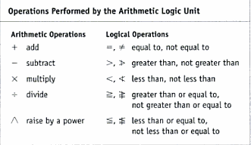
Central Process Unit (CPU)
Arithmetic and Logic Unit
This unit consists of two subsections:
Arithmetic Section:
Function of arithmetic section is to perform arithmetic operations like addition, subtraction, multiplication, and division. All complex operations are done by making repetitive use of the above operations.
Logic Section:
Function of logic section is to perform logic operations such as comparing, selecting, matching, and merging of data.

Slide 13
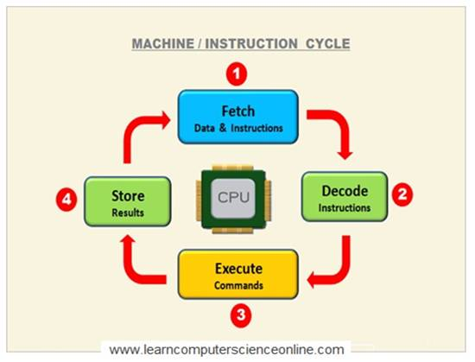
Central Process Unit (CPU)
Machine Cycle
The steps performed by the computer processor to execute each instruction.
Machine cycle is further divided into four parts
Fetch: Control Unit retrieve the instruction from memory
Decode: Before execution instruction is being break down into opcode(operation code)
Execute: Instructions are being executed.
Store: CPU requires to store the result in memory.

Slide 14
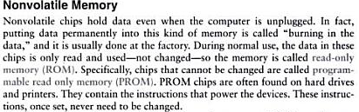
Memory

Slide 15
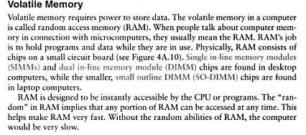
Memory

Slide 16
System Bus
The system bus is a pathway composed of cables and connectors used to carry data between a computer microprocessor and the main memory. The bus provides a communication path for the data and control signals moving between the major components of the computer system.
The system bus works by combining the functions of the three main buses, each of the three buses has its separate characteristics and responsibilities.
Data Buses: which is a bidirectional path, carries the actual data between the processor, the memory and the peripherals.
Address Buses: used to specify memory locations for the data being transferred.
Control Buses: carries the control, timing and coordination signals to manage the various functions across the system.

Slide 17
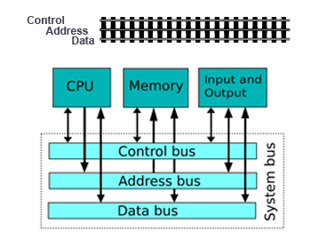
System Bus

Slide 18
Factors Affecting Processing Speed
Registers
The CPU contains of small memory areas: called registers, which store data and instructions while the CPU processes them.
The size of the registers determines the amount of data with which the computer can work at a one time.
Today most PC`s have 32-bit registers, mean the CPU can process four bytes data at one time. Register sizes are rapidly growing to 64 bits.
RAM
The amount of RAM in a PC has a direct affect on the system`s speed.
The more RAM a PC has, the more program instructions and data can be held in memory, which is faster than storage on disk.

Slide 19
Factors Affecting Processing Speed
The System Clock
The computer`s system clock sets the pace the CPU by using a vibrating quartz crystal.
A single "tick" of the clock is the time required to turn a transistor off and back on. This is called a clock cycle.
Clock cycles are measured in Hertz(Hz),a measure of cycles per second. If a computer has a clock speed of 300 MHz, then its system clock "ticks" 300 million times every seconds.
The faster a PCs clock runs, the more instructions the PC can execute each second.
Cache Memory
Cache memory is high-speed memory that holds the most recent data and instructions that have been loaded by the CPU.
Cache is located directly on the CPU or between the CPU and RAM, making it faster than normal RAM.
The amount of cache memory has a tremendous impact on the computer`s speed.

Slide 20
THE END

Slide 21
Introducing Computer Systems

Slide 22
Definition of Computer
In basic terms, a computer is an electronic device that process data, converting it into an information that is useful to people.
Any computer regardless of its type, is controlled by programmed instructions which give a machine a purpose and tell it what to do.

Slide 23
Computers for Individual Users
Desktop
Workstations
Laptops
Notebook Computers
Tablets
Smart Phones

Slide 24
Computers for Organizations
Network Servers
Mainframe Computers
Super Computers

Slide 25
Why Computers are so Important?
Manage your schedule on daily or hourly basis
Manage List of contacts
Send faxes and e-mails
Carry your data with you
Be able to work anywhere
Communicate and share data from anywhere
Education
Entertainment
Home based business
Military
Police
Healthcare

Slide 26
Parts of Computer System
Hardware
Software
Data
User

Slide 27

Parts of Computer System
Hardware

Slide 28
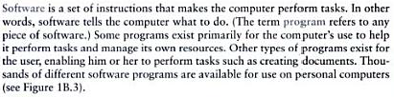
Parts of Computer System
Software

Slide 29

Parts of Computer System
Data
User
People are the computer operators

Slide 30
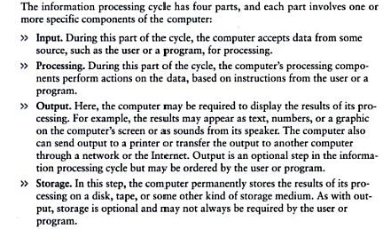
Information Process Cycle

Slide 31
Essential Computer Hardware
Processor
Memory
Input/Output
Storage

Slide 32
Essential Computer Hardware
Processor: A central processing unit (CPU), also called a central processor or main processor, is the electronic circuitry within a computer that executes instructions that make up a computer program. The CPU performs basic arithmetic, logic, controlling, and input/output (I/O) operations specified by the instructions in the program.
Most modern CPUs are microprocessors, where the CPU is contained on a single metal-oxide-semiconductor (MOS) integrated circuit (IC) chip.

Slide 33

Essential Computer Hardware
Memory: In computing, memory refers to a device that is used to store information for immediate use in a computer or related computer hardware device
RAM (Random Access Memory)
ROM (Read Only Memory)
ROM permanently stores its data even if the computer is shut off.
ROM is called non-volatile memory because it never loses its contents.

Slide 34

Essential Computer Hardware
Input/Output:
Examples of Input Devices:
Keyboard
Touchpad
Scanner
Digital Camera
Microphone
Joystick
Mouse etc
Examples of Output Devices:
Screen
Speaker
Printer
Digital Camera etc

Slide 35

Essential Computer Hardware
Storage:
Types of Storage
Magnetic Storage
Optical Storage

Slide 36
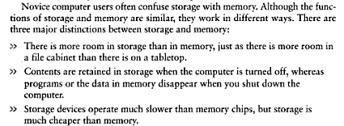
Difference between Storage and Memory

Slide 37
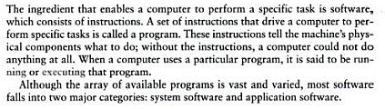
Software

Slide 38
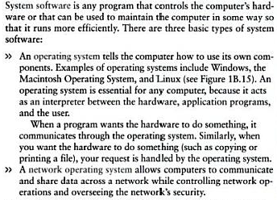
System Software

Slide 39
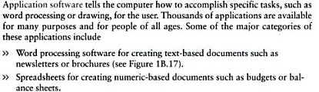
Application Software
More Examples:
Database Management Software
Presentation Programs
Graphic Programs
Multimedia Authoring Applications
Entertainment and Education Software
Web Design Tool ad Web Browsers

Slide 40
SOFTWARES

Slide 41
Software - Definition

Slide 42
Types of Software
Software is divided into to major categories:
System Software
Application Software

Slide 43
System Software

Slide 44
Application Software
More Examples:
Database Management Software
Presentation Programs
Graphic Programs
Multimedia Authoring Applications
Entertainment and Education Software
Web Design Tool ad Web Browsers

Slide 45
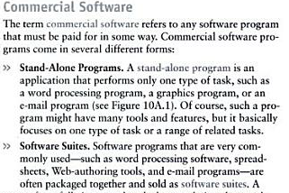
Commercial Software

Slide 46
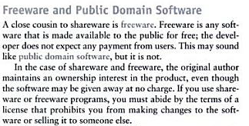
Freeware Software

Slide 47
Open-source Software
Open-source software (OSS) is a type of computer software in which source code is released under a license in which the copyright holder grants users the rights to use, study, change, and distribute the software to anyone and for any purpose.

Slide 48
Application Program - Examples
Word Processing Programs
Spreadsheets Programs
Presentation Programs
Graphic Software (paint programs, photo editing programs, draw programs, computer aided design programs, 3-D modeling and animation program)

Slide 49
Reading Assignment
Topics:
Word Processing Programs (e.g. MS Word)
Spreadsheets Programs (e.g. MS Excel)
Presentation Programs (e.g. MS Power Point)
Graphic Software (photo editing programs, draw programs, computer aided design programs,)

